Slide 1
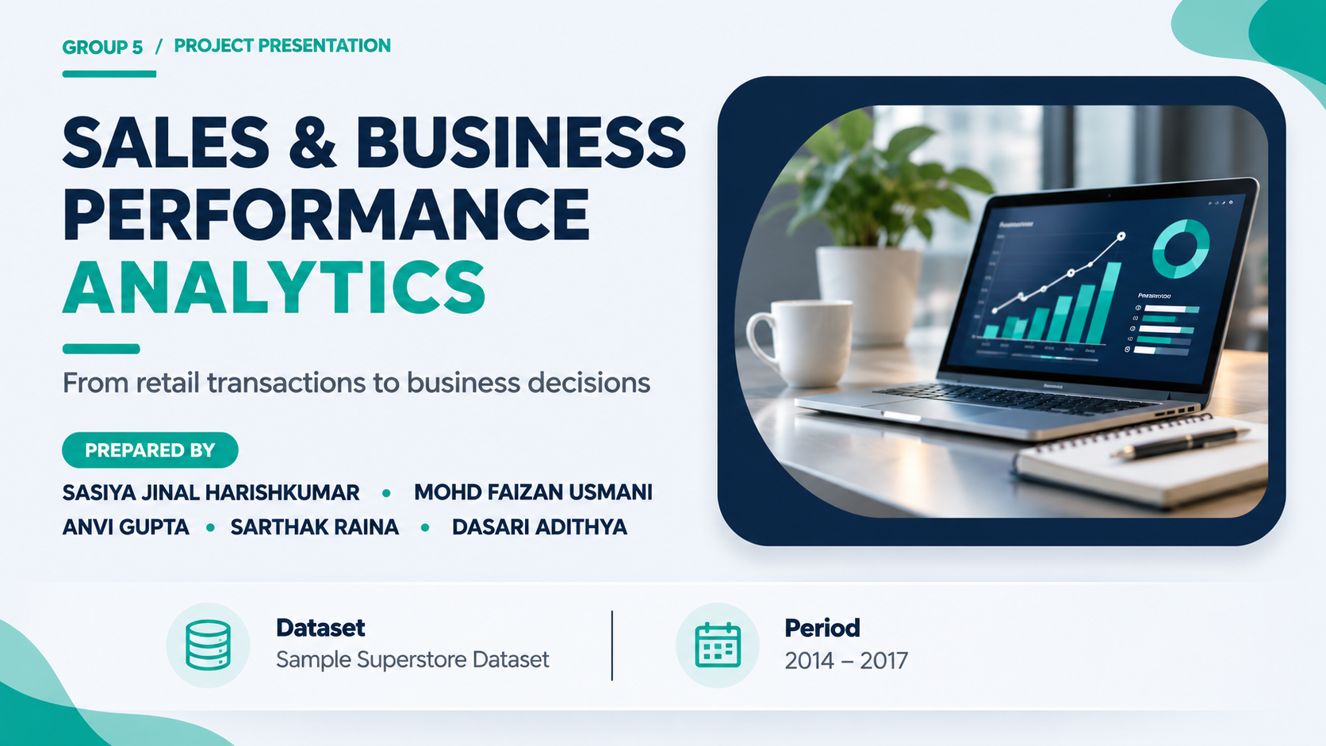

Slide 2
GROUP 5 / SALES & BUSINESS PERFORMANCE ANALYTICS
The business question behind the analysis
A four-part analytical journey
OUR OBJECTIVE
Understand what drives sales —
and, more importantly,
what drives profit.
PREPARE
Clean and validate order, return and people data.
01
EXPLORE
Compare performance across products, regions, segments and time.
02
MEASURE
Track sales, profit, orders, customers and margin.
Translate transaction-level data into clear performance insights and practical business recommendations.
03
ACT
Convert findings into pricing and performance recommendations.
04
SAMPLE SUPERSTORE • 2014–2017
02

Slide 3
GROUP 5 / SALES & BUSINESS PERFORMANCE ANALYTICS
A four-year view of retail activity
TRANSACTION ROWS
DISTINCT ORDERS
CUSTOMERS
COVERAGE
9,994
5,009
793
2014–17
Order-line records
Unique Order IDs
Unique customers
Four calendar years
THREE SOURCE TABLES
IMPORTANT DISTINCTION
ORDERS
Transaction, customer, product, shipping, sales, discount and profit details.
9,994 rows
≠ 9,994 orders
RETURNS
296 distinct returned Order IDs.
PEOPLE
Regional manager mapping for four regions.
The dataset contains multiple product lines within a single order. We count distinct Order IDs for order-level measures.
SAMPLE SUPERSTORE • 2014–2017
03

Slide 4
GROUP 5 / SALES & BUSINESS PERFORMANCE ANALYTICS
Build a reliable dataset before measuring performance
DATA PREPARATION PIPELINE
01
02
03
04
05
STANDARDIZE
›
TYPE-CHECK
›
INTEGRATE
›
ENGINEER
›
VALIDATE
Column names and text values
Dates, postal codes and numeric fields
Join return flags using Order ID
Year, month, quarter and YearMonth fields
Missing values, duplicates and business rules
QUALITY CHECK RESULTS
DISTINCT RETURNED ORDERS
MISSING VALUES
DUPLICATE ORDER ROWS
296
0
0
Matched to Orders
After cleaning
No duplicate rows found
Return flags repeat across line items; returned orders are counted using distinct Order IDs, not flagged rows.
SAMPLE SUPERSTORE • 2014–2017
04

Slide 5
GROUP 5 / SALES & BUSINESS PERFORMANCE ANALYTICS
The headline numbers: scale, value and profitability
TOTAL SALES
TOTAL PROFIT
ORDERS
$2.297M
$286.4K
5,009
Revenue generated
Profit after recorded costs
Distinct Order IDs
CUSTOMERS
AVG. ORDER VALUE
PROFIT MARGIN
793
$458.61
12.47%
Unique customers
Sales ÷ distinct orders
Profit ÷ sales
Reading the scorecard: strong revenue is only part of the picture — margin shows how much of that revenue becomes profit.
SAMPLE SUPERSTORE • 2014–2017
05

Slide 6
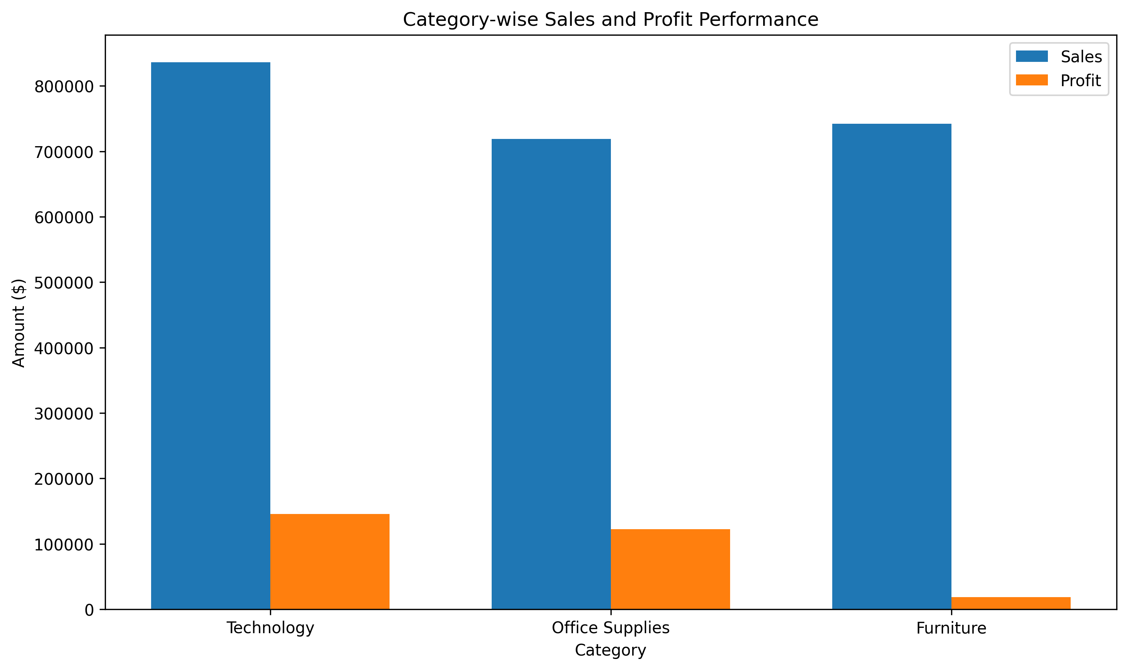
GROUP 5 / SALES & BUSINESS PERFORMANCE ANALYTICS
Technology leads — Furniture is the margin challenge
Sales and profit by product category
TOP CATEGORY
USD
Technology
$836.2K sales • $145.5K profit
HIGHEST QUANTITY
Office Supplies
22,906 units sold
LOWEST CATEGORY MARGIN
Furniture
2.49% profit margin
SAMPLE SUPERSTORE • 2014–2017
06

Slide 7
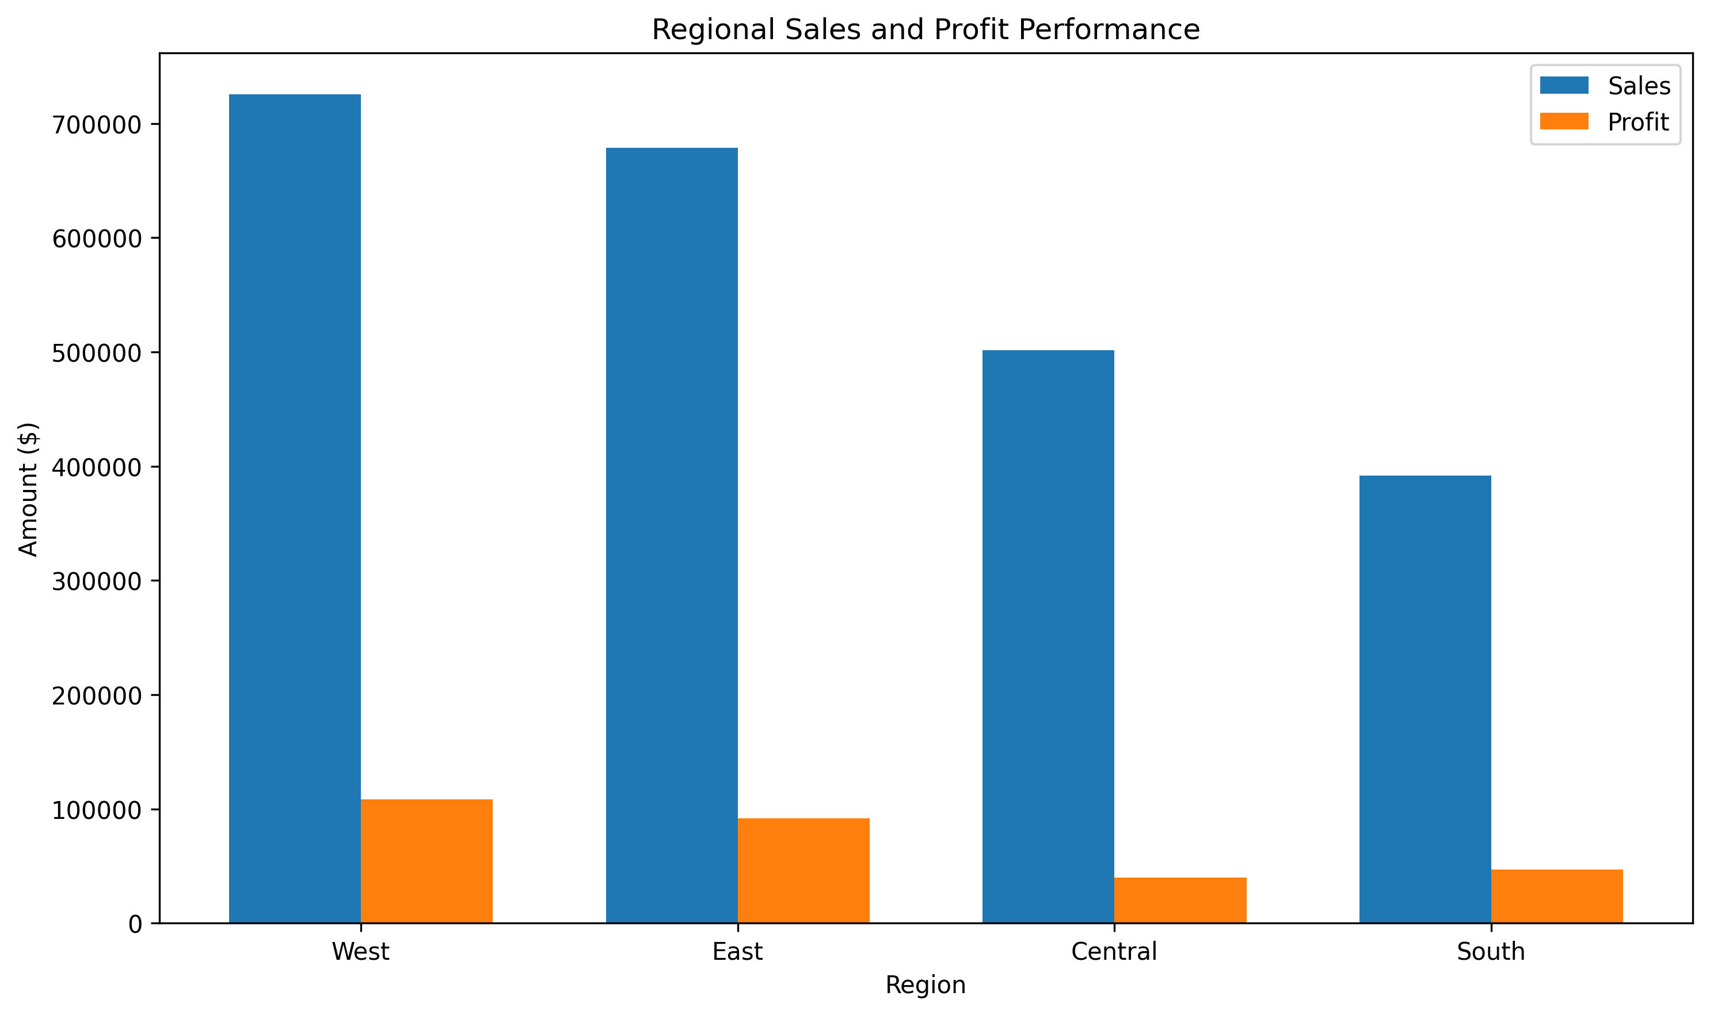
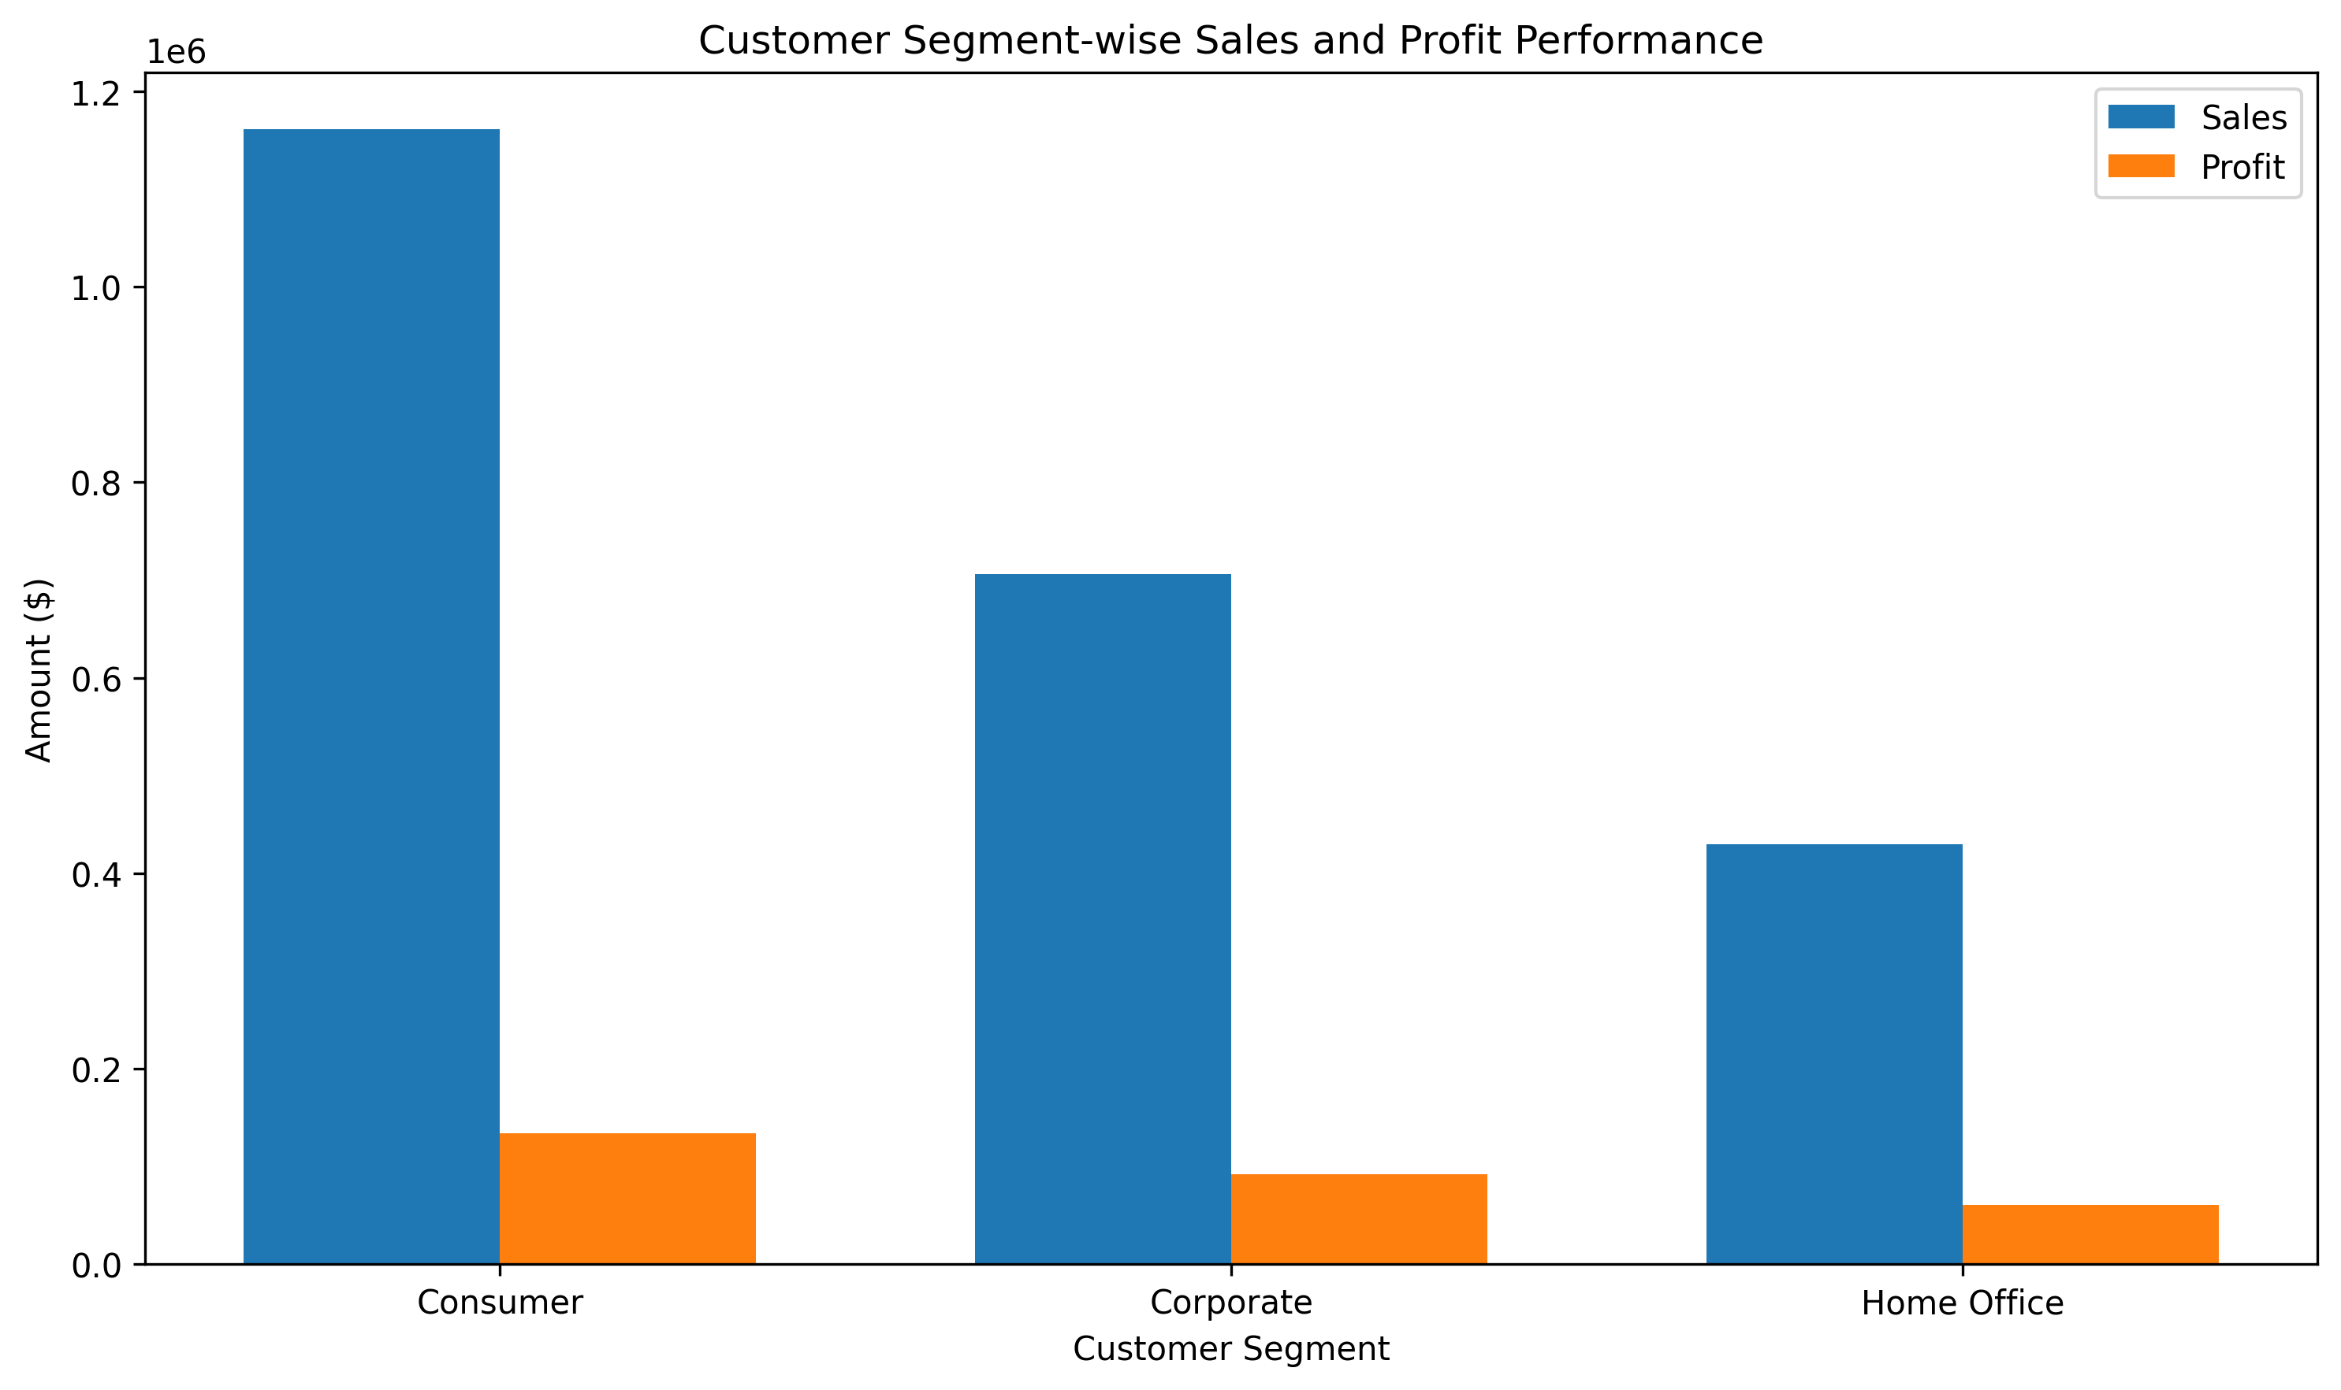
GROUP 5 / SALES & BUSINESS PERFORMANCE ANALYTICS
Performance changes by geography and customer type
Regional sales and profit
Customer segment performance
Four-region comparison
Sales, profit and margin
WEST • Highest regional sales ($725.5K) and profit ($108.4K)
HOME OFFICE • Highest segment margin (14.03%)
SAMPLE SUPERSTORE • 2014–2017
07

Slide 8
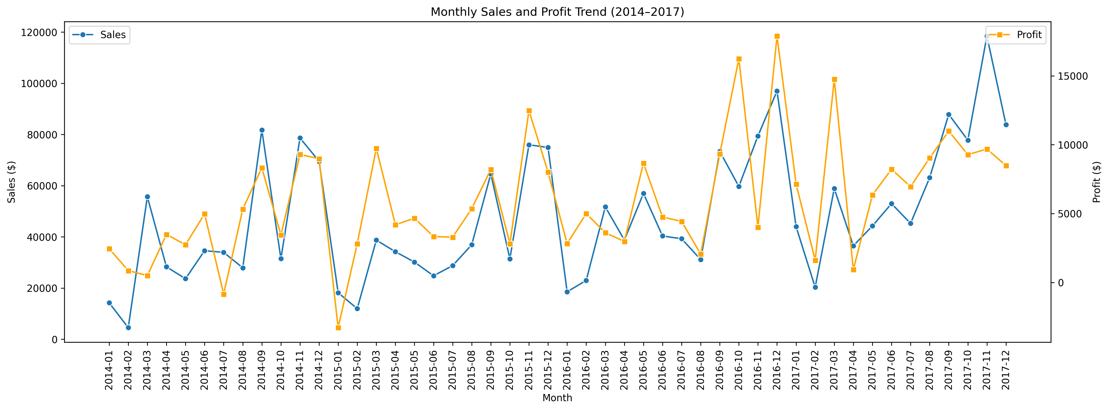
GROUP 5 / SALES & BUSINESS PERFORMANCE ANALYTICS
Growth strengthened over the four-year period
Monthly sales and profit trend
Seasonality and month-to-month movement
2017 / STRONGEST YEAR
$733.2K
Annual sales
$93.4K
Annual profit
1,687
Orders in 2017
Sales grew 20.36% vs. 2016.
Annual comparison
SAMPLE SUPERSTORE • 2014–2017
08

Slide 9
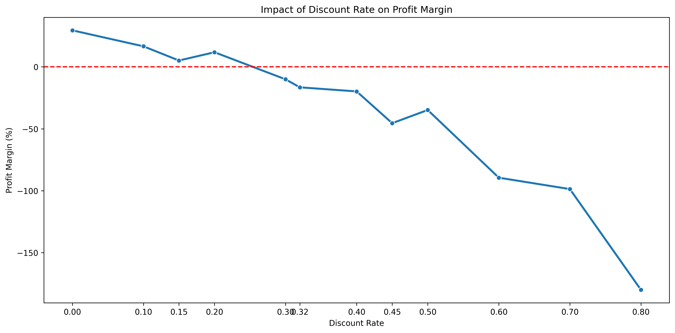
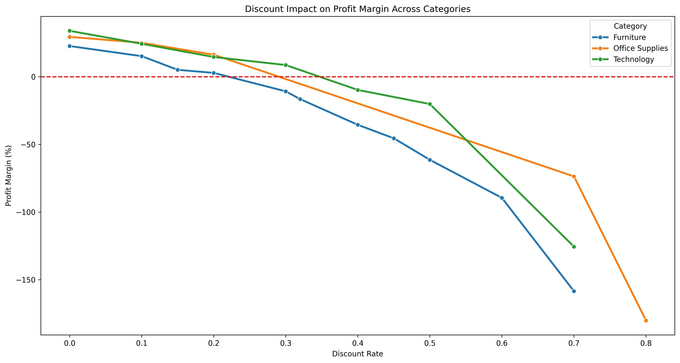
GROUP 5 / SALES & BUSINESS PERFORMANCE ANALYTICS
Higher discount bands coincide with weaker margins
Discount level and profit margin
Discount impact by category
Overall relationship
Category-level variation
INTERPRETATION NOTE • This is an observed association, not proof that discounts alone caused losses; product mix and order context also matter.
SAMPLE SUPERSTORE • 2014–2017
09

Slide 10
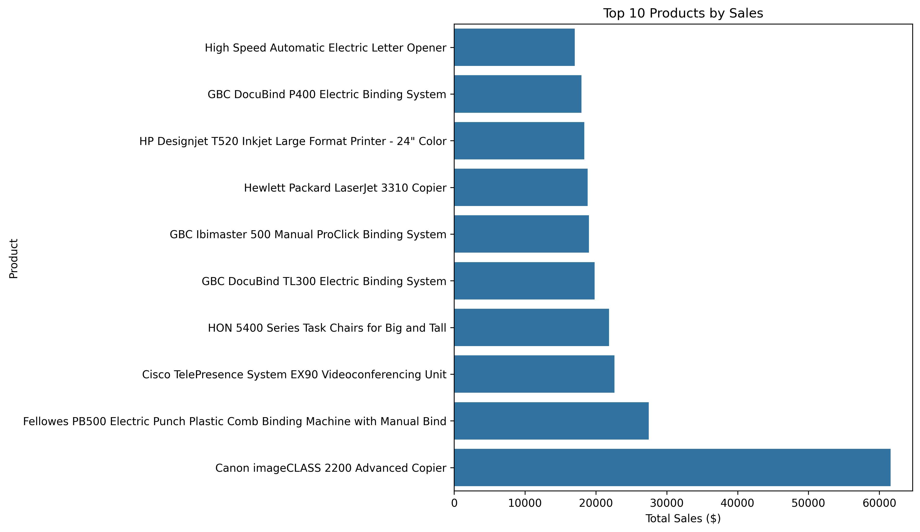
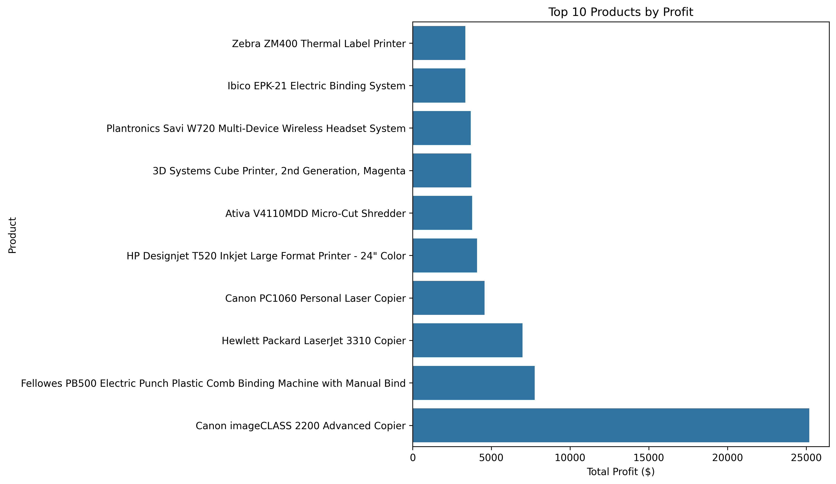
GROUP 5 / SALES & BUSINESS PERFORMANCE ANALYTICS
Revenue leaders are not always profit leaders
Product sales and profit comparison
Product profit distribution
Top products by sales
Profit variation across products
TOP PRODUCT • Canon imageCLASS 2200 Advanced Copier leads both sales and profit; some high-sales products still record losses.
SAMPLE SUPERSTORE • 2014–2017
10

Slide 11
GROUP 5 / SALES & BUSINESS PERFORMANCE ANALYTICS
What the analysis says — and what the business can do
01 / KEY FINDINGS
02 / BUSINESS RECOMMENDATIONS
01
Technology leads category sales and profit.
PROTECT
Continue to support strong Technology performers.
02
Furniture and the Central region have weaker margins.
REVIEW
Investigate Furniture costs, pricing, returns and discounts.
03
Consumer contributes the largest sales and profit totals.
TARGET
Examine Central region performance by state and product mix.
04
2017 is the strongest year across sales, profit and order count.
CONTROL
Set discount guardrails and monitor contribution margin.
SAMPLE SUPERSTORE • 2014–2017
11

Slide 12
GROUP 5 / SALES & BUSINESS PERFORMANCE ANALYTICS
Interpret the results within the limits of the dataset
01
DATASET SCOPE
02
MISSING BUSINESS CONTEXT
The Sample Superstore dataset is a limited sample of retail activity. Findings may not generalize to every retailer or market.
Transactions show what happened, but do not explain why a discount was offered or why a product became unprofitable.
03
OBSERVATIONAL ANALYSIS
04
RETURN GRANULARITY
Discount and profit patterns show association, not causation. Product mix and order-level factors may also influence outcomes.
Returns are identified at order level while Orders contains line items. Distinct Order IDs are used to avoid overstating return counts.
SAMPLE SUPERSTORE • 2014–2017
12

Slide 13
GROUP 5 / SALES & BUSINESS PERFORMANCE ANALYTICS
Conclusion
01
02
03
GROWTH
PERFORMANCE GAPS
PRICING DISCIPLINE
Sales and profit increased over the four-year period, with 2017 delivering the strongest annual results.
Technology led category performance, while Furniture and the Central region need closer margin review.
Higher discount bands often aligned with weaker margins; pricing should be reviewed alongside product mix.
OVERALL BUSINESS IMPLICATIONS
Protect profitable growth, investigate weak margins, and use evidence from the dashboard to guide pricing and performance decisions.
SAMPLE SUPERSTORE • 2014–2017
13

Slide 14


